Slide 1




AT82.02
Data Modeling and Management
Unit 7-1: Data Engineering
Chutiporn Anutariya (chuti at ait dot ac dot th)

Slide 2
Outline
Data Science and Data Analytics Process: An Overview
Data Engineering: An Overview
Data Engineering: A Practice

Slide 3
Data Science and Data Analytics Process
An Overview

Slide 4
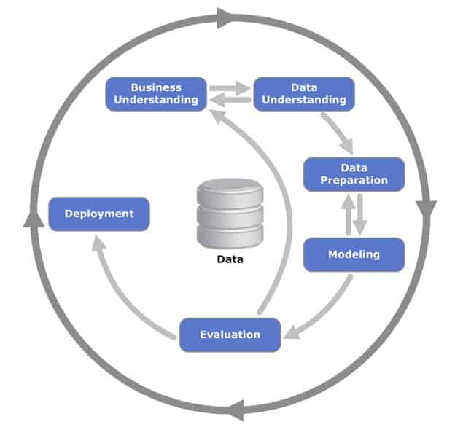
CRISP-DM
The CRoss Industry Standard Process for Data Mining (CRISP-DM) is a process model with six phases that naturally describes the data science life cycle.

Slide 5
CRISP-DM: Business Understanding
Determine business objectives
Assess situation
Determine data mining goals
Produce project plan

Slide 6
CRISP-DM: Data Understanding
Collect initial data
Describe data
Explore data
Verify data quality

Slide 7
CRISP-DM: Data Preparation
Select data
Clean data
Construct data
Integrate data
Format data

Slide 8
CRISP-DM: Data Preparation
Select data
Clean data
Construct data
Integrate data
Format data

Slide 9
CRISP-DM: Modeling
Select modeling technique
Generate test designs
Build model
Assess model

Slide 10
CRISP-DM: Evaluation
Evaluate results
Review process
Determine next steps

Slide 11
CRISP-DM: Deployment
Plan deployment
Plan monitoring and maintenance
Produce final report
Review project

Slide 12
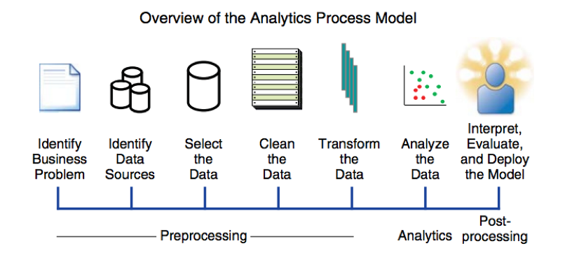
Business Analytics Process Model
Src: https://blogs.sas.com/content/sgf/2019/05/14/big-data-in-business-analytics-talking-about-the-analytics-process-model/

Slide 13
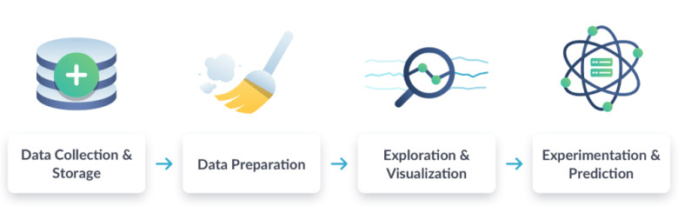
Data (Analytics) Workflow
Src: DataCamp

Slide 14

TDSP: Team Data Science Process
An agile, iterative data science methodology to deliver predictive analytics solutions and intelligent applications efficiently
Combination of Scrum and CRISP-DM
Ref: Microsoft Team Data Science Lifecycle (Microsoft, 2020)

Slide 15
Business Understanding
Data Acquisition and Understanding
Data Science Process Lifecycle
Modeling
Deployment
Customer Acceptance

Slide 16
TDSP: BUSINESS UNDERSTANDING
TASK 1.1
Define objectives: discuss with the client as well as with the various stakeholders in order to understand and identify the business challenges. Formulating questions that define the business objectives that data science techniques can achieve.
Step1: Identify the main business variables that the analysis needs to predict. These variables should be interpreted as the model destinations and associated metrics used to determine the success of the project.
Step2: Define project goals by asking "precise" questions that are relevant, specific and unambiguous.

Slide 17
TDSP: BUSINESS UNDERSTANDING
Usually five types of questions are used:
How much or how many?
(regression)
What group? (group)
What category? (classification)
Is that weird? (anomaly detection)
Which option should be adopted? (recommendation)
It must be determined, however, what questions to ask and how the answer will achieve your business objectives.

Slide 18
TDSP: BUSINESS UNDERSTANDING
Step3: Define the project team specifying the roles and responsibilities of the most varied members. Develop a plan in order to find out more information or even their sources.
Step4: Define the metrics of success.
The metrics should be SMART :
Specific
Measurable
Achievable
Relevant
Time-bound

Slide 19
TDSP: BUSINESS UNDERSTANDING
TASK 1.2
Identify data sources: Find the relevant data that helps to answer the questions that define the project objectives.
Step1: Look up the following data:
Data relevant to the question. Do you have target measures and resources related to the target?
Data that is an accurate measure of your model destination and resources of interest.
For example, you may consider that existing systems may need to collect and record additional types of data to solve the problem. In this situation, you may need to look for external data sources or update your systems to collect new data.

Slide 20
TDSP: DATA ACQUISITION AND UNDERSTANDING
TASK 2.1
Ingest the data into the target analytic environment.
Step1: Process configuration to move data from the source to the destination where the analytical operations are performed.

Slide 21
TDSP: DATA ACQUISITION AND UNDERSTANDING
TASK 2.2
Explore the data to determine if the data quality is adequate to answer the question.
Step1: Before training the models, it is necessary to develop a good understanding of the data. The data sets collected from the most diverse sources are often noisy, have no value or have a number of other discrepancies.
Step2: Compress and analyze the data to audit its quality and provide the necessary information to process the data before they are ready for modeling. This process is often iterative.

Slide 22
TDSP: DATA ACQUISITION AND UNDERSTANDING
TASK 2.3
Set up a data pipeline to score new or regularly refreshed data.
Step1: In addition to initial data ingestion and cleaning, it is necessary to set up a process to obtain new data or update it regularly as part of an ongoing learning process. At this stage, a data pipeline solution architecture must be developed.
Step2: The pipeline should be situated in parallel with the next step of the data science project. Depending on the business needs and constraints of the existing systems into which this solution is being integrated, the pipeline can be one of the following options:
Batch-based
Streaming or in real time
A hybrid

Slide 23
TDSP: MODELING
TASK 3.1
Feature engineering: Create data features from the raw data to facilitate model training.
Step1: Feature engineering involves the inclusion, aggregation and transformation of raw variables to create the resources used in the analysis.
Step2: It is essential to understand how resources relate to each other and how machine learning algorithms should use these resources.
Step3: Feature engineering is an act of finding and including informational variables, and trying to avoid unrelated variables.

Slide 24
TDSP: MODELING
TASK 3.2
Model training: Find the model that answers the question most accurately by comparing their success metrics.
Step1: Divide the input data randomly for modeling into a training data set and a test data set.
Step2: Build the models using the training data set.
Step3: Evaluate the training and test data set. Choose some competing learning algorithms as well as the various associated adjustment parameters that are oriented to answer the question of interest with the current data.
Step4: Determine the "best" solution to answer the question by comparing the success metrics between alternative methods.

Slide 25
TDSP: MODELING
TASK 3.3
Determine if your model is suitable for production.

Slide 26
TDSP: DEPLOYMENT
TASK 4.1
Operationalize the model: Deploy the model and pipeline to a production or production-like environment for application consumption.
Step1: Once you have a set of models that work well, they should be operated for other applications to consume. Depending on the business needs, forecasts are made in real time or in batch. To implement models, the API interface must be exposed.
The interface allows the model to be easily consumed from various applications, for example:
Online sites
Spreadsheets
Instrument panels
Line-of-business applications
Back-end applications

Slide 27
TDSP: CUSTOMER ACCEPTANCE
TASK 5.1
System validation: Confirm that the deployed model and pipeline meet the customer's needs.
TASK 5.2
Project hand-off: Hand the project off to the entity that's going to run the system in production.

Slide 28
Outline
Data Science and Data Analytics Process: An Overview
Data Engineering: An Overview

Slide 29
Data Engineering
An Overview

Slide 30
Data Engineer
Data engineers deliver the correct data in the right form to the right people as efficiently as possible.
Build and maintain the organization’s data pipeline systems.
Clean and wrangle data into a usable state.
Data engineers primarily focus on the following areas:
ETL: Extract > Transform > Load
ELT: Extract > Load > Transform

Slide 31
Which steps are part of Data Engineering process?

Slide 32
Construct your dataset

Slide 33
Dataset: Size
“Garbage in, garbage out”
How much data? It depends on the project!
Data set | Size (number of examples)
Iris flower data set | 150 (total set)
MovieLens (the 20M data set) | 20,000,263 (total set)
Google Gmail SmartReply | 238,000,000 (training set)
Google Books Ngram | 468,000,000,000 (total set)
Google Translate | trillions

Slide 34

Characteristics of Dataset Quality

Slide 35
Dataset: Quality
Characteristic | How to measure
Accuracy | Is the information correct in every detail?
Completeness | How comprehensive is the information?
Reliability | Does the information contradict other trusted resources?
Relevance | Do you really need this information?
Timeliness | How up- to-date is information? Can it be used for real-time reporting?

Slide 36
Clean and Transform Data

Slide 37
Data Cleansing
Data Cleansing (or Data Cleaning) is the process of identifying incorrect, irrelevant incomplete or the “dirty” parts of a dataset and then cleaning them.
The process of data cleansing may involve the removal of typographical errors, data validation, and data enhancement.
Data Cleansing Methods:
Removal of unwanted data
Removal of duplicate data
Removal of irrelevant data
Correct mistaken/erroneous data
Filter-out outliers
Resolving inconsistencies / missing data:
Dropping vs Imputing a value

Slide 38
Data Transformation
The process of converting data from one format to another, typically from the format of a source system into the required format of a destination system.
Filtering (e.g. Selecting only certain data fields/records).
Enriching (e.g. Full name to First Name , Middle Name , Last Name).
Splitting a column into multiple columns and vice versa.
Cleansing — (sometimes cleansing is defined as part of data transformation) inconsistencies and missing values in the data are resolved.
Standardization — formatting rule are applied to the data set.
Deduplication — redundant data is excluded or discarded.
Verification — unusable data is removed and anomolies are flagged.
Sorting — data is organized/grouped.
Other tasks — any additional/optional rules can be applied to improve data quality.
Joining together data from multiple sources.
Labeling.

Slide 39
Data Engineering
A Practice

Slide 40

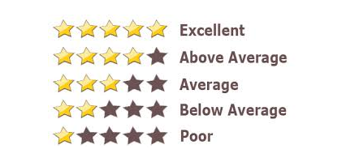
Movie Rating Prediction
Movie rating is an important element to decide movie quality.
People prefer to use rating as reference to decide whether to watch a movie or not.
We plan to use historical values of the movie as features (e.g. genres) and the user profiles (e.g., age, gender) to predict movie rating before the movie released.
Notes:
https://www.kaggle.com/sherinclaudia/movie-rating-prediction
Movie prediction is an important way to predict movie revenue and performance. Through data analysis, we can find the most popular genres, performance in recent years and how it affects the reputation of the next movie. As movie production incurs huge cost and efforts, our effort is to predict the percentage of success, so that production could be managed accordingly.

Slide 41
Movie Rating Prediction
Datasets: Movies, User Profiles, User Rating
The variables used for input:
Age, Gender, Occupation, Movie Category
The variables used for model prediction:
User Rating
source: https://www.kaggle.com/sherinclaudia/movie-rating-prediction

Slide 42



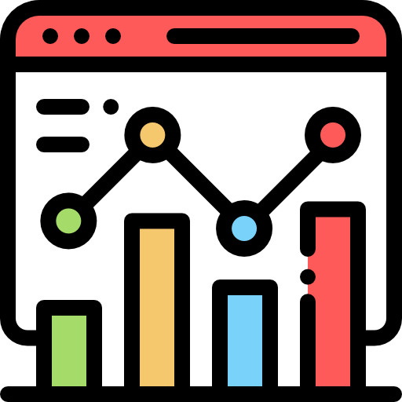
Movie Rating Prediction
Input
Output
Movies DB
ETL Process
Prediction Model
User Profiles
Movie Ratings by Users
Data Visualization
Notes:
Icons made by <a href="https://www.flaticon.com/authors/freepik" title="Freepik">Freepik</a> from <a href="https://www.flaticon.com/" title="Flaticon"> www.flaticon.com</a>

Slide 43




Movie Rating Prediction
Output
Input
ETL Process
Movies DB
Step1: get movie data from RDB and convert data to CSV file
Step2: get user profile in CSV format
Step3: get movie rating by users from MongoDB
3.1 export data JSON file
3.2 convert Json to CSV file
Comedy
…
Rating
movie
movie_category
Extract
1
...
2
0
..
3
Relational Database
1
..
4
User Profiles
CSV for Prediction
Step.4 Cleans, Transform and Integrate
4.1 Remove Duplicate Records
4.2 Dealing with Missing Values
4.3 Integrate 3 datasets
4.4 Convert birthdate to age 4.5 Convert gender to numeric
4.6 Filter age >= 7
CSV File
Transform
Movie Rating by Users
Export to json
CSV for Visualization
MongoDB
Load
Step.5 Write output as CSV files

Slide 44

Thank you.
Let’s Summarize!

